Slide 1
Conditional Random Field [2]
Joohyung Lee

Slide 2
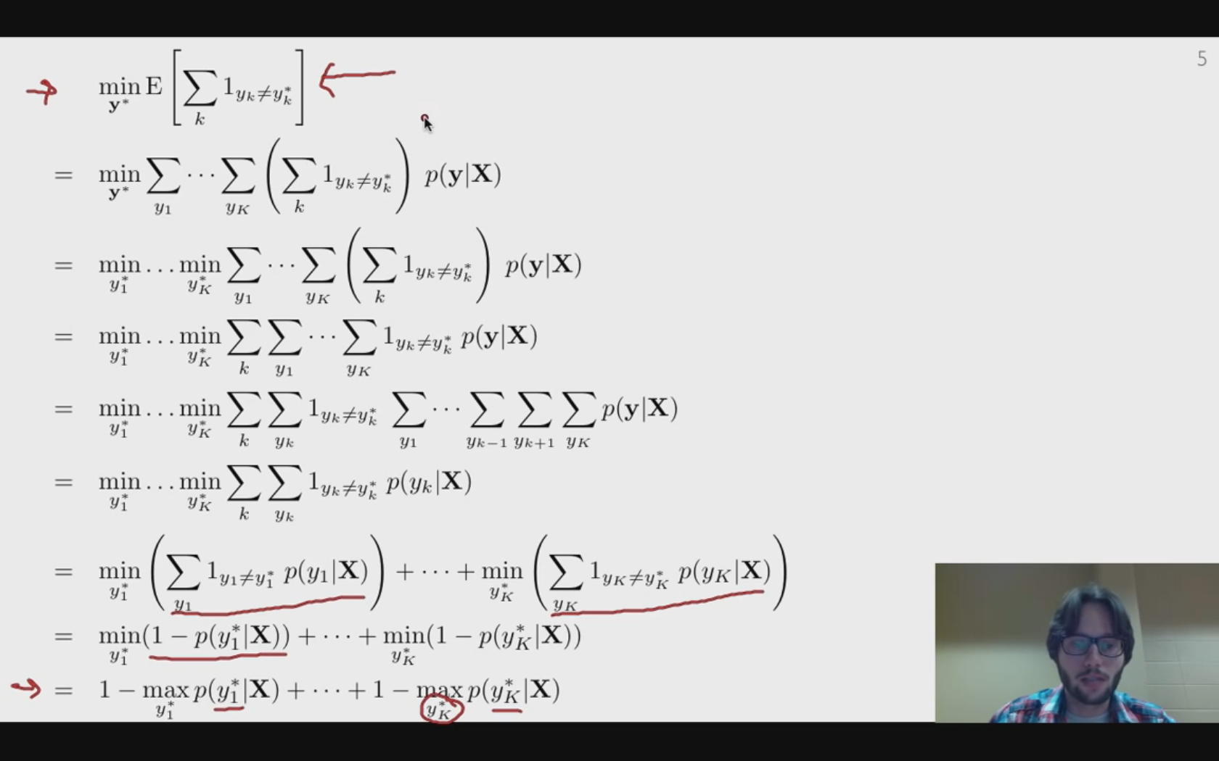
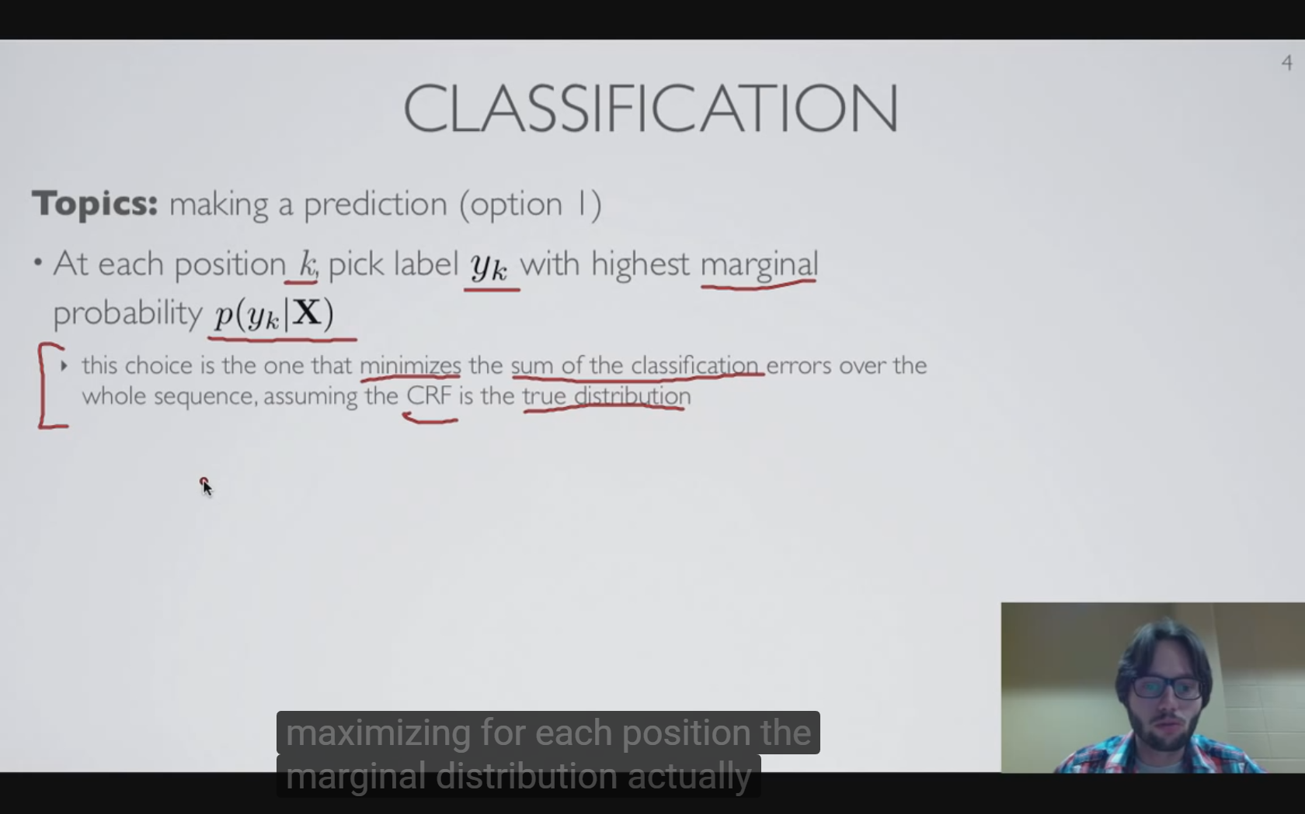
Sequence Classification
Unpackaging ‘expectation’
Unpackaging vector minimization
At each position k, pick y_{k} with highest marginal probability p(y_{k}|X)
Naïve, Minimization of the sum of the classification errors (assuming CRF is the true distribution)
Minimization in expectation of sum of classification error per position
Given the true labels generated by the Linear CRF model, if want to minimize the expected classification error per position => produce sequence of all labels that maximize the probability of being observed according to the model for each position in constructing my prediction by concatenating all of these sequence
Joint PMF to Marginal PMF

Slide 3
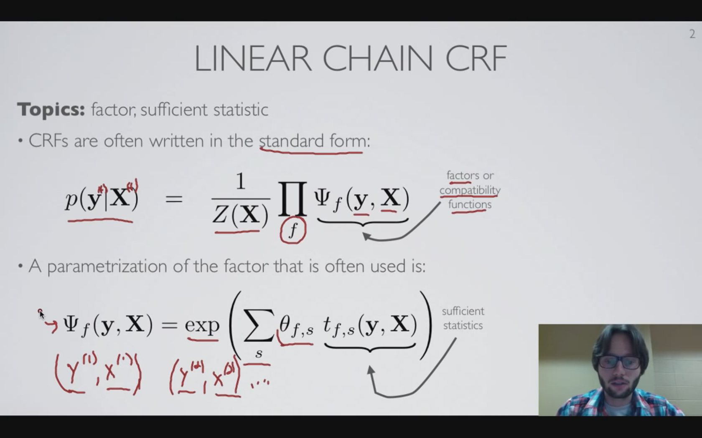
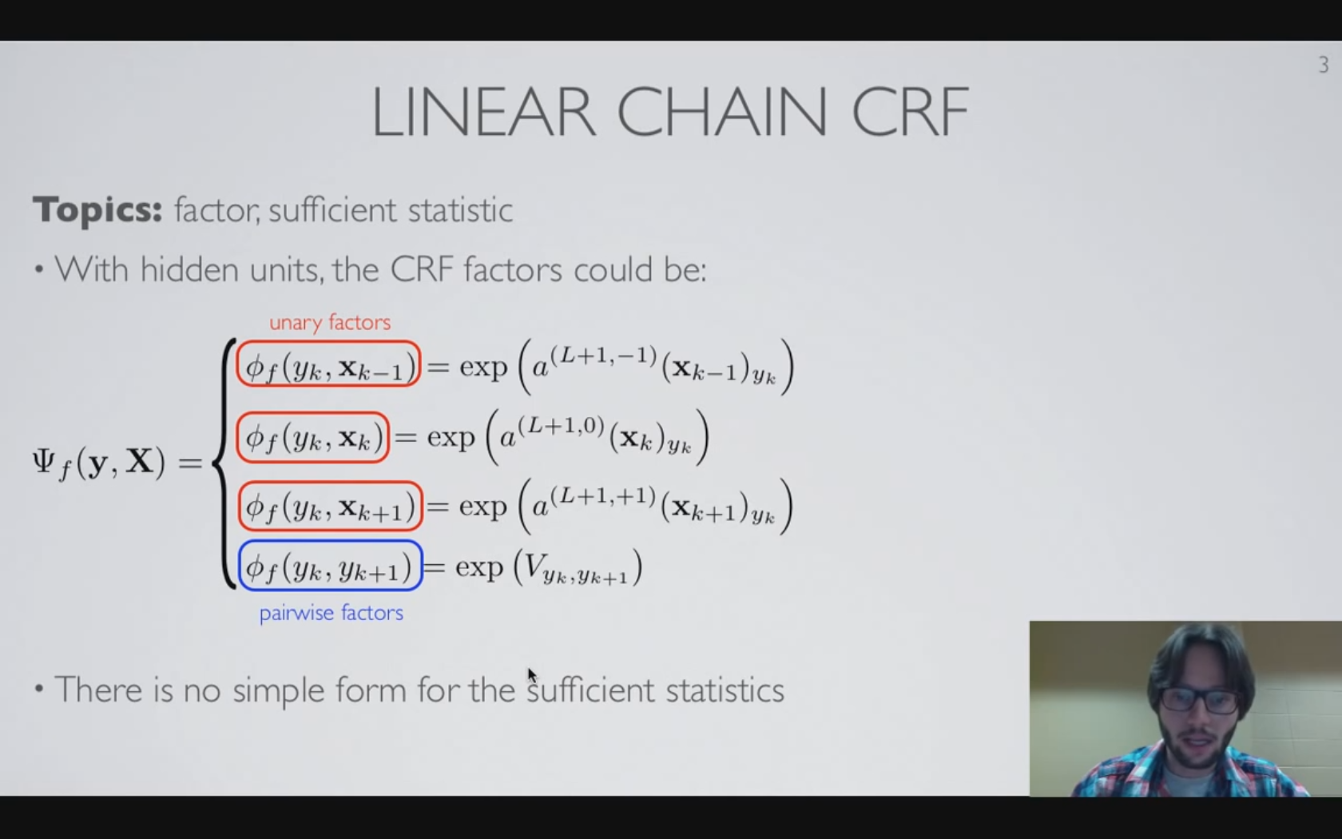
Several concepts: -Factors, sufficient statistics, Linear CRF
CRF representation: exponential of the sum of all the sufficient statistics(features)
No simple form because those terms cannot be written as parameter times a deterministic features (non-linear unary activation)
Notes:
Theta: parameter, t: features(sufficient statistics)

Slide 4
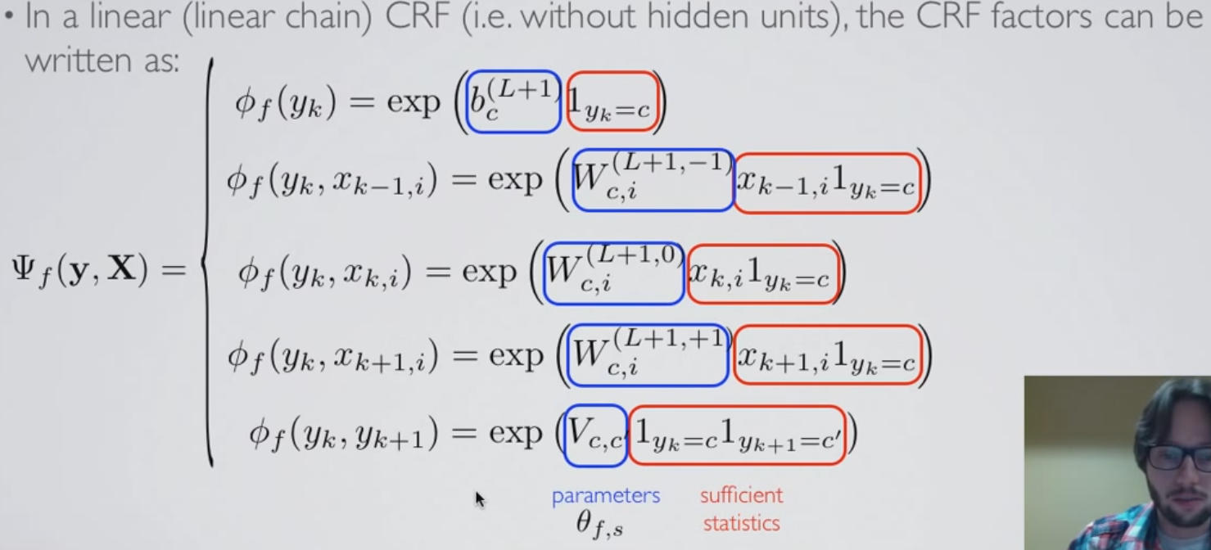
Linear CRF
Linear: pre-activation function is linear function of the input
Sufficient Statistics: In log linear model, statistics that are useful in predicting the labels.
Notes:
I is just an index within many elements of input

Slide 5
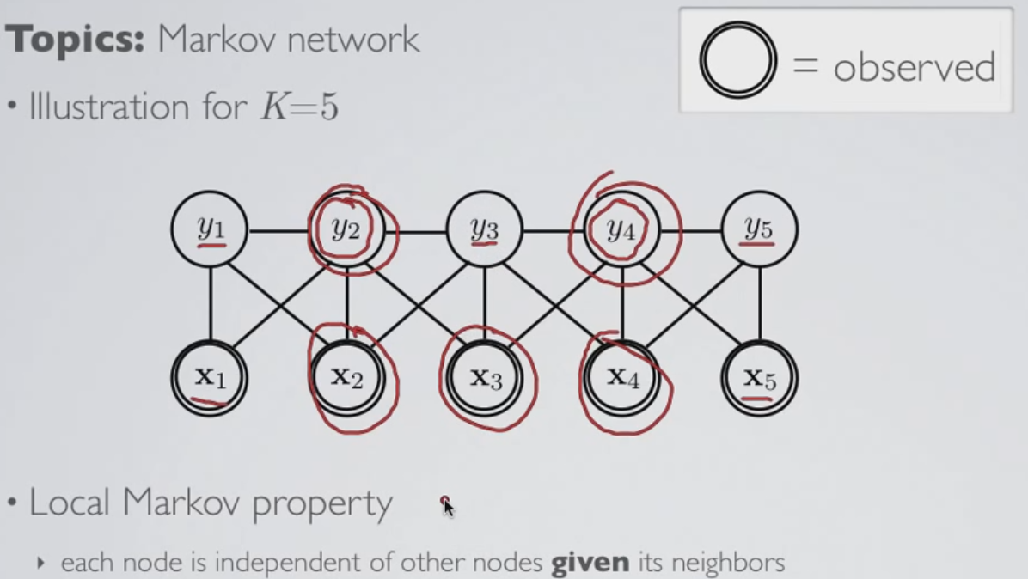
Markov Random Field
Useful visualization of a conditional random field model: Markov network
Node: Random variable of model; shares factors for CRF(product of factor form)
Usefulness: easy to determine (in)dependencies between nodes
Node is independent of other nodes given its neighbors
Conditional independent if all paths between them contain at least one of the conditioning node

Slide 6
Directed vs. Undirected
Undirected (such as CRF)
Only requirement: non-negative factor
Directed (such as Bayesian network)
Each edge corresponds to the conditional probability in the model
Sum to one (normalization property)
Identifying conditional independence
Undirected: easy
Directed: Due to directedness and subject to normalization property with conditional distribution

Slide 7
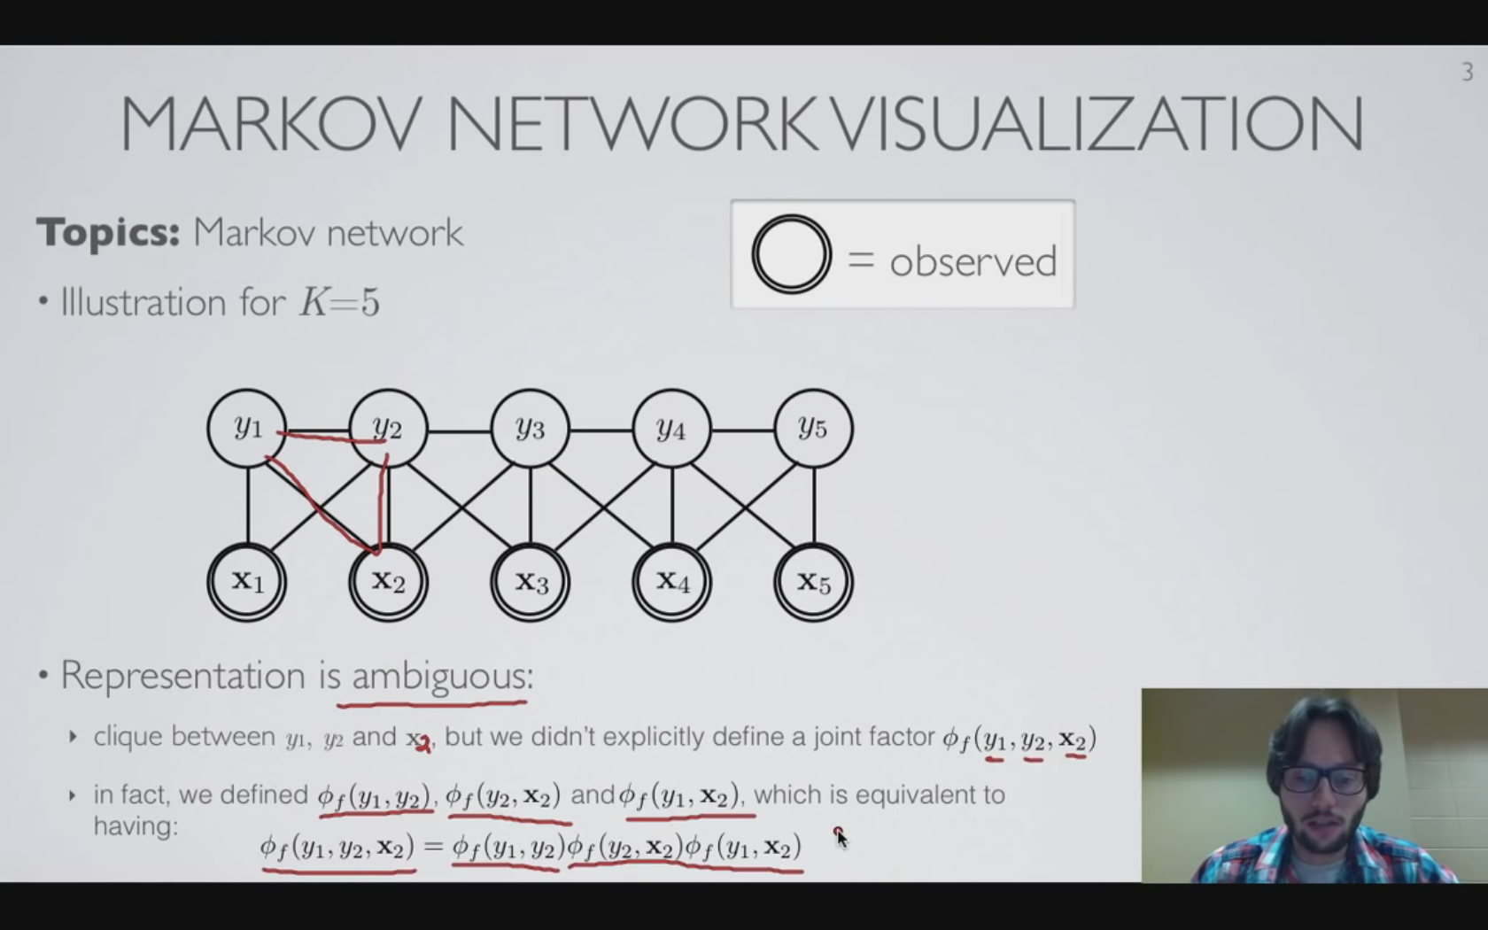
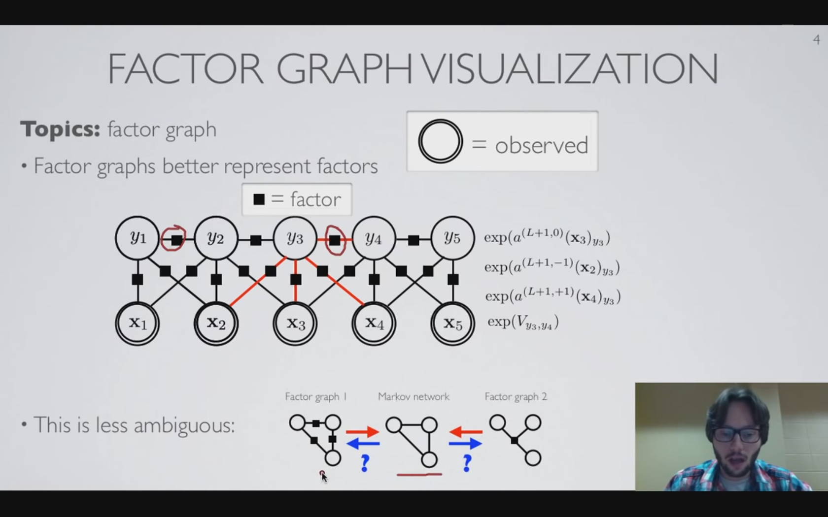
Factor Graph
Markov Network (current visualization method)
Alternative for visualizing undirected graphical model like CRF
Edge b/w each node that share at least one factor
Need to distinguish the clique
Factor Graph(second type of visualization)
Add node(usually little black square) in the graph that directly correspond to a factor
Each factor node is connected to its argument which is the random variables that are correspond to arguments of the factor
Clears some ambiguity incurred by clique
Factor graph may be less intuitive but contains more information.
When only independence is important but not the actual factor, Markov net may be favored, but in case there is a need for actual factors, Factor graph is a solution.

Slide 8
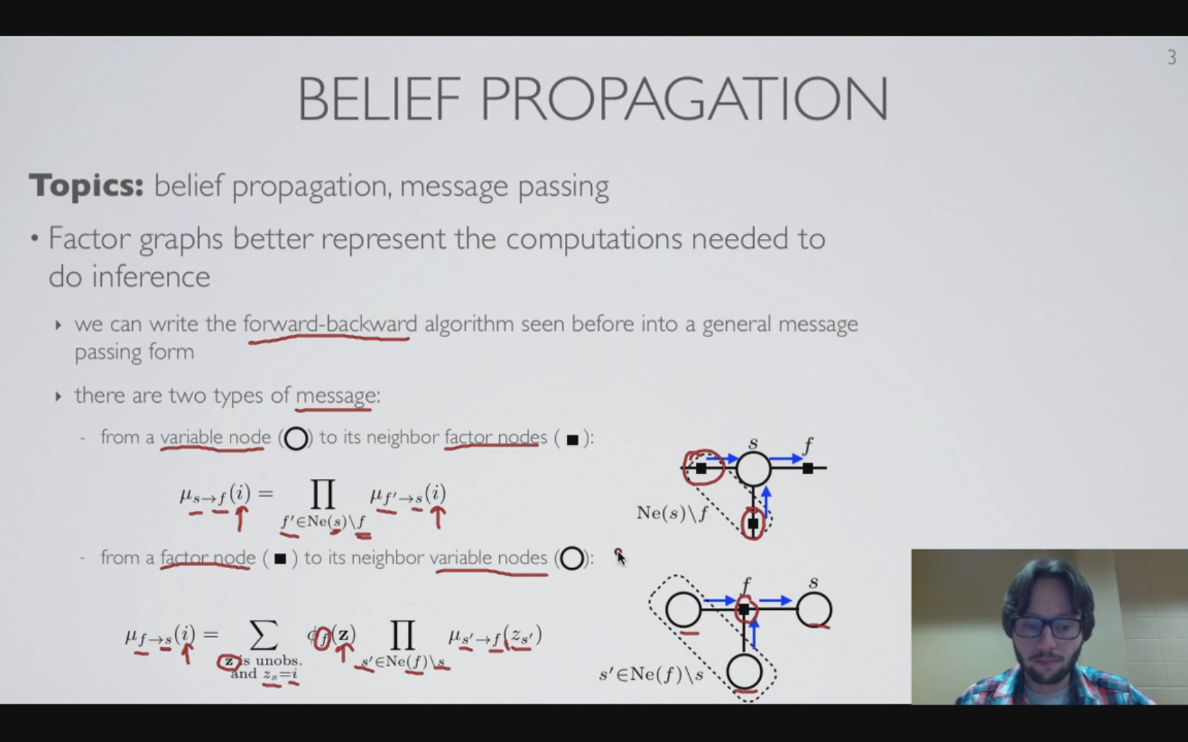
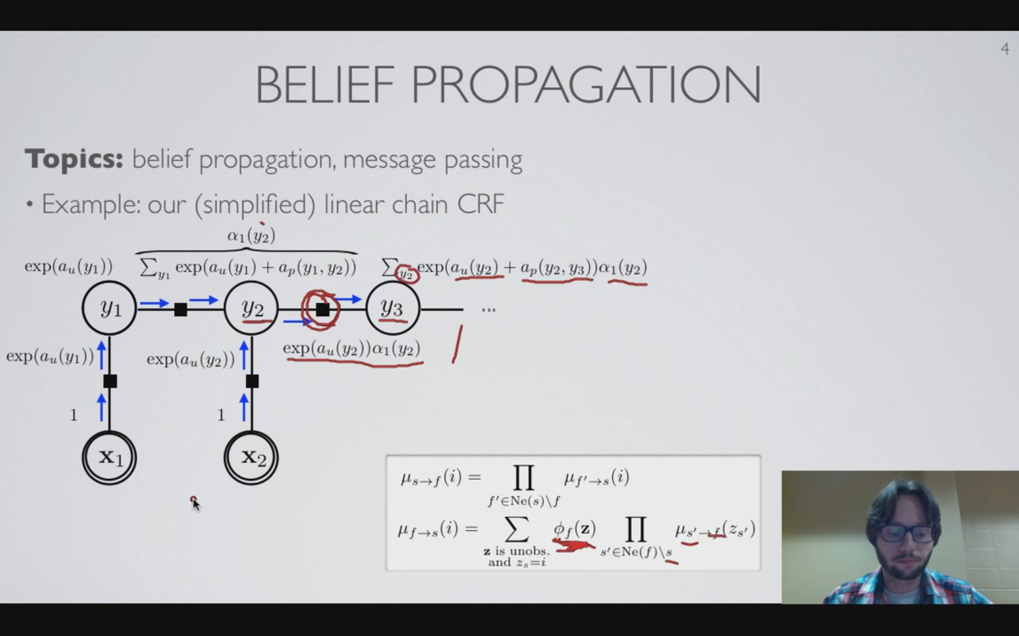
Belief Propagation
General algorithm for performing inference in general conditional random fields known as belief propagation
F->V: multiplication of all simultaneous flux-in, but weighted(by factor) sum in all the potential set of values the connected variables (to f) can take
Continue the message propagation, all of the equations for the values of the alpha (columns of the alpha table) will be recovered.
Belief propagation from (left to right / right to left): (alpha / beta) table column
Notes:
3.10

Slide 9
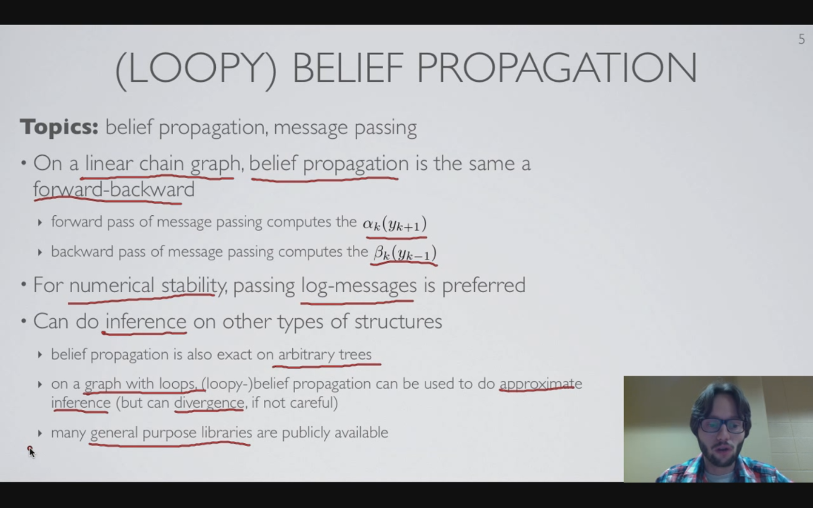
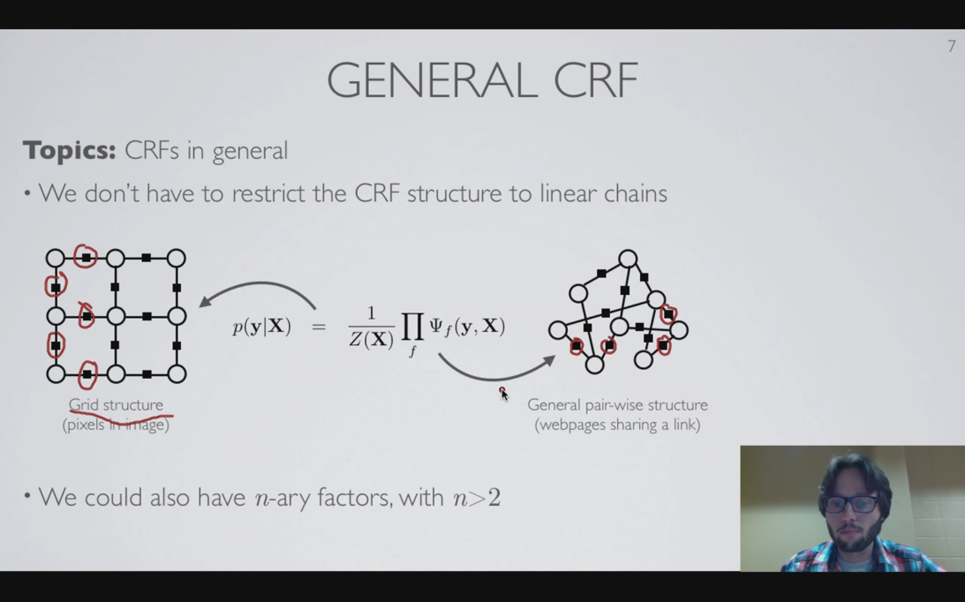
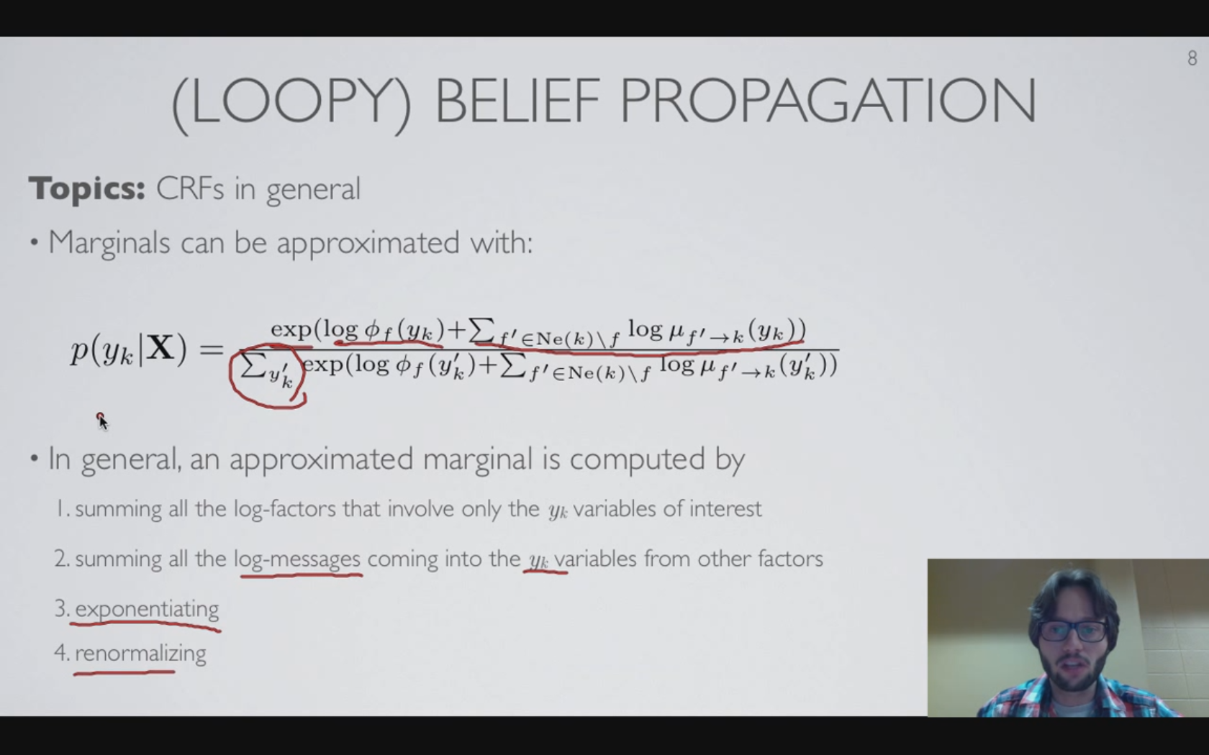
Belief Propagation
Trick to make convergence: Not override when update the message, but consider the weighted average of the past message and the current message (cf. optimization method)
Any connection structure is possible (even triplet). Loop belief propagation is also possible (convergence is not guaranteed)
Notes:
3.10

Slide 10
References
From “Neural Network” by Hugo Larochelle. Lec 3.6~3.10
https://www.youtube.com/user/hugolarochelle

